Slide 1

CA22123 EU-MACE: Core Group monthly update GP2 #3
Virtual
21/01/2025

Slide 2
meeting Agenda
Shall we record?

Slide 3
0. Happy New Year!
Update on Action management/organization
MC/WG meeting in Burghausen in March 2025
Logistics
Agenda
TOTEMIC Training school!
MAP & Expert List – ChainMap update
EUROMAT2025
FutureLabLive
AOB

Slide 4
Action management and organization

Slide 5
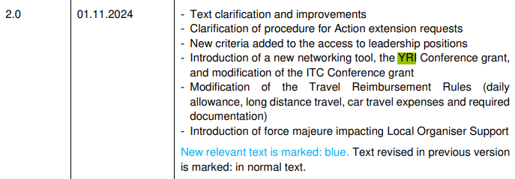
Grant agreement, news from COST Asso
Grant Agreement:
GH LR encountered problem during e-signature ➔ COST Officers and Help-desk alerted. Expected to resolve the issue soon.
New Rules: As of Nov 2024
Most significant change: 3 types of conference grants = Dissemination, ITC & YRI grants are now possible.
➔ Priority definition meeting in February ➔ to be presented at MC meeting in March
Download the NEWEST COST RULES

Slide 6
Next hybrid MC and WG/Task meeting

Slide 7
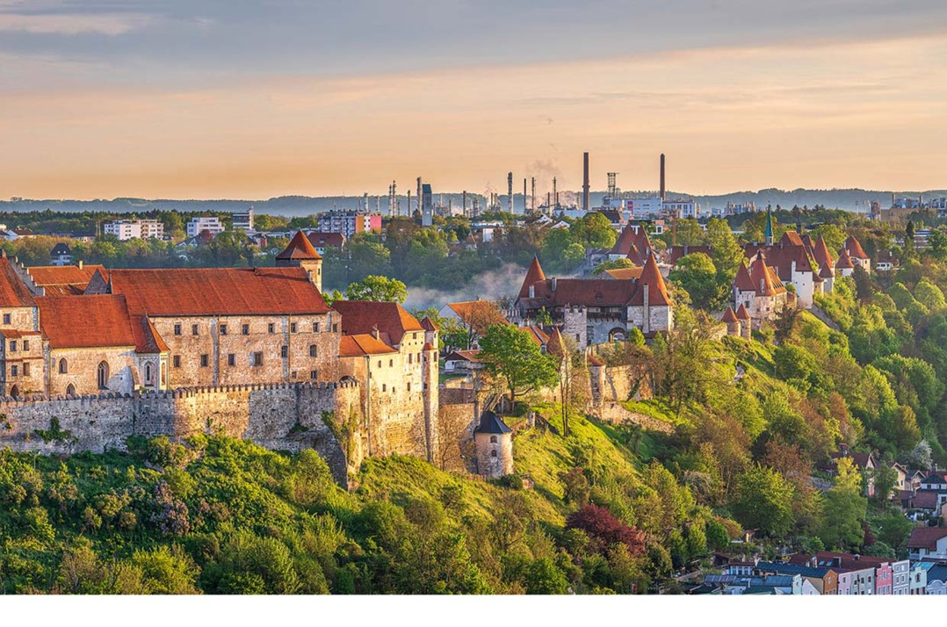
Burghausen, Germany – TH Rosenheim
March 6 & 7, 2025
LOS: Dorottya Kriechbaumer

Slide 8
Practical information
Nearby airports: Munich (100 km), Salzburg (50 km)
Shuttle service can be arranged by Campus team
Cost: under negotiation (accomodation: >100€/night)
Support from Campus Burghausen
Optional:
Visit to Container Labs (Project Reallabor)
Invite Wacker/Linde/Borealis?

Slide 9
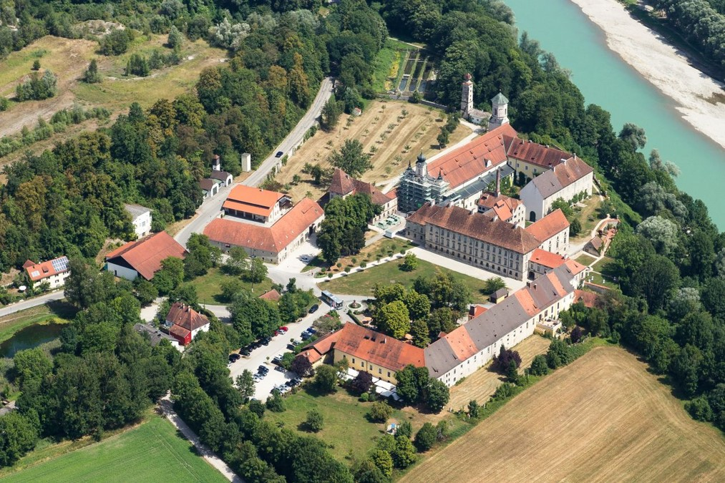
Event Location
Akademiezentrum Raitenhaslach
https://www.raitenhaslach.tum.de/
Meeting rooms and accomodation at the same location
Transportation and accommodation info to be communicated by Dorottya
Shuttle services from airports
Official Invitation to be sent by next week: As soon as GHLR e-signs the GA!!
MC and WG/Task core members are invited

Slide 10
Agenda (tentative) ➔ changed after the meeting, final agenda on Action website!
Day 0: Arrival
Day 1 | Day 2
Morning | Morning
- MC meeting (hybrid): 3.5 hours | WG3 session II (new mat. TDM) workshop
Lunch @ cafeteria | Lunch @ cafeteria
Afternoon | Afternoon
1. Legacy Lab workshop: 2 hours | 1. WG1 & WG2 (hybrid)
2. WG3 session I (hybrid): 2 hours TDM review and industrial perspective | 2. AOB
Dinner | Departure

Slide 11
MC meeting points of discussion
General information transmission
MC decisions
New WG leaders and task leaders
STSM and Conference grant priorities
Training school - summary
Expert and MAP Database (Chainmap)
Euromat 2025 update & Future LabsLive
Young EU-MACE seminars (can be a part of WG1&2 sessions)
Industrial relations & next training school (GP3/4)

Slide 12
WG & Task leader mandate
New positions and New nominations to be approved by MC
WGs & Task | current | Next GP candidates
WG1 – perovskites | Helge Stein (DE) | Dorottya Kriechbaumer (DE, YRI)
WG2 – metallic alloys | Jarek Jasinski (PL) | Jarek Jasinski (PL) – on going activity
WG3 – New materials | Kourosh Malek (DE) | Kourosh Malek (DE) – on going activity
WG4 - training | David Lacroix (FR) | D. Lacroix until May 2025 ➔ Antonio P. Goncalves
WG5/Communications | I. Matejak (BE) | Gloria Botton (BE, YRI)
Grant Award committee | Holger Ihssen (DE) | Peter Tatarko (SK, YRI)
Sustainability | G. Campana (IT) | Giampaolo Campana – just started new activity
Inter-COST Action actions? | Saco Nakamae (AC/FR) | Anyone ???
Young EU-MACE | New | Anyone ???
Erasmus incubation | Theodora Kyratsi (CY) | Theodora Kyratsi (CY)
MAP & EXP List/database | Kourosh Malek (DE) | Ioisif Galanakis (EL)
Legacy Labs | New | Ozlem Ozcan (DE)
Industrial leadership? | New | To be discussed @ MC meeting
Notes:
Ozlem: legacy lab through dataflow. For automation it’s good to have less advanced

Slide 13
TOTEMIC traing school – David & Gloria

Slide 14
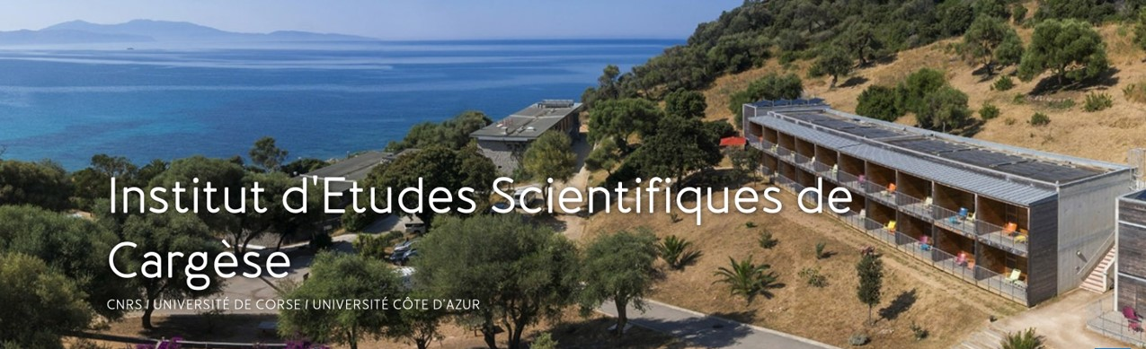
TOTEMIC 2025 training school
Tools for Energy Materials Modelling Acceleration Training school: Application ending SOON
April 20 – 26, 2025
Cargèse, Corsica, France
In-house School (lodging at the IESC is mandatory)
Joint organization with CNRS (France) GdR NAME
Co-chair from EU-MACE : David Lacroix
12 confirmed speakers
https://eu-mace.eu/event/4908:training-school-2025-totemic.html
Application: +60 but only 50% complete with CV and motivation
EU-MACE provides 15 financial supports = Daily allowance + long distance travel
Daily allowance includes in-house accommodation + dinner ~ 72€/day
YRIs only (priority = PhDs and Postdocs)
Selection in mid February
Please encourage your students/postdocs to apply

Slide 15
Map and expert database – Iosif!

Slide 16
B2B platform for MAP & Expert list
CHAINMAP Platform update (internal trial version)
Created by Kourosh Malek (DE)
Managed by Iosif Galanakis (EL)
34 replies (but only 20 correctly formatted)
Onboarding presentation recorded
List will be locked on January 31st (focused on material classes)
Refining & harmonizing the collected data
Expansion (expertise, infrastructures (MAP), sub-categories of new materials, etc.)
Discussion at next MC meeting
Expansion/share beyond EU-MACE (industries, other COST Actions, etc.)

Slide 17

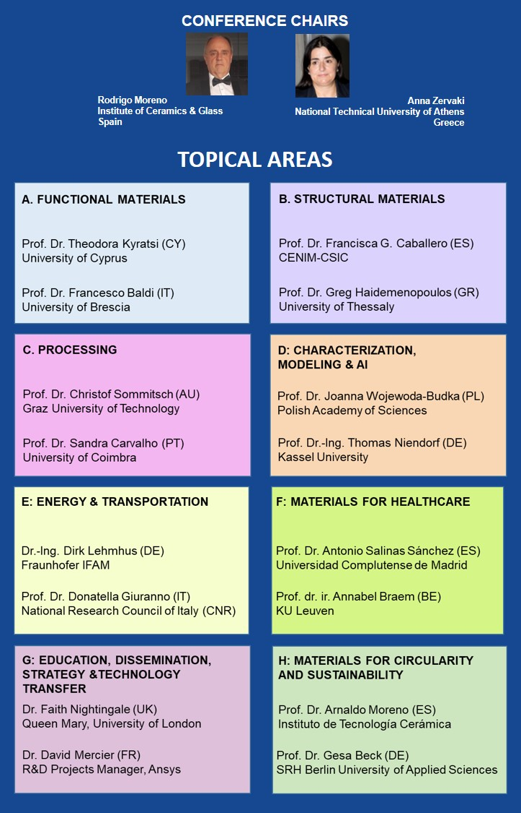


Notes:
17

Slide 18
EUROMAT 2025
Topics, organization, etc.
50 – 80 attendees (hybrid)
September 14, 2025
Registration is independent from EUROMAT
Can support ~20-25 attendees for the forum (but NOT the conference)
Special provision for 5-10 YRI’s + ITC conference grants (max 2000€ each)
Topics ➔
Organization committee from EU-MACE
Theodora Kyratsi
Antonio P Sanjuan (local organizer)
Jaroslaw Jasinksi
Monica Fabrizio
Holger Ihssen
Sawako Nakamae
Erika Hodulova
Accelerated device integration: by unifying digital and materials competency (Increasing SDLs & MAPs capacities via horizontal collaborations)
Continued growth (Further education). Adapting one’s ‘traditional’ training to the fast-changing dynamics toward the digital-driven and holistic research approach is a formidable challenge faced by many senior investigators.
Organizatin meeting planned for early February

Slide 19
details on EUROMAT forum topics
Topics, audience and stakeholders at EUROMAT 2025
Accelerated device integration : How do advanced, functional (new or improved) materials find their way into technology?
Stake holders:
SMEs specialized in prototyping : how to find such companies? How do they design, build and validate prototypes? What are the following stages in the innovation chain?
Digital twin specialists (overlap with point i above): who are they? How to contact them?
Funding sources: Device development costs money. Who invests money into this innovation step? Public and private funding schemes, where to find venture capitalists and what are the key criteria they use to determine in which materials/devices to invest/fund?
Audience: researchers, educators, students, industries
Continued growth (Further education): How to liaise local, isolated experimental/numerical practice to MAPs?
Stake holders:
Energy materials researchers whose methodologies do not include automation, AI assisted analysis/simulation, high-throughput characterization, or sustainability analysis… etc.
Automation specialists, ML software developer, LCA scientists
SMEs who want to assist in building prototypes, or benefit from Action partner labs
Can be made into a project matchmaking session that participants sign up beforehand to present their R&D ambitions

Slide 20
Next meetings/discussions
Action monthly meeting:
February 18th @ 3pm
MORE MC & WG meeting details

Slide 21
Thank you for your attention !!

Slide 22
Thank you for your attention !!

